Slide 1

STAT 5 DISCUSSION
TA: Yongqi Chen
Email: ychen574@ucsc.edu
Office hour: Mon 1PM - 2PM (BE 151) & Tue 11 AM – 12 PM (BE 151)

Slide 2
Self Introduction
BA in mathematics and statistics: Rutgers University (New Brunswick, NJ)
Ph.D. in statistics: University of California, Santa Cruz (Santa Cruz, CA; 1st Year Ph.D. student)

Slide 3
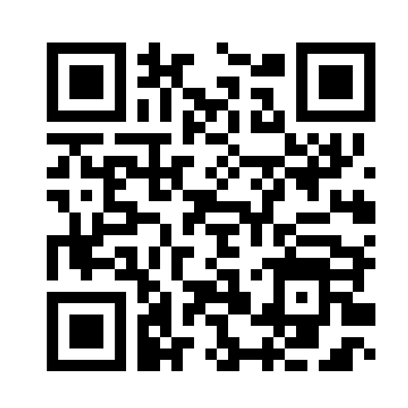
For today’s discussion…
Solve some assignment problems → It’s ok if you haven’t read all the reading assignments. We will go over some of the concepts together through solving assignment problems.
If you have questions, feel free to ask!

Slide 4
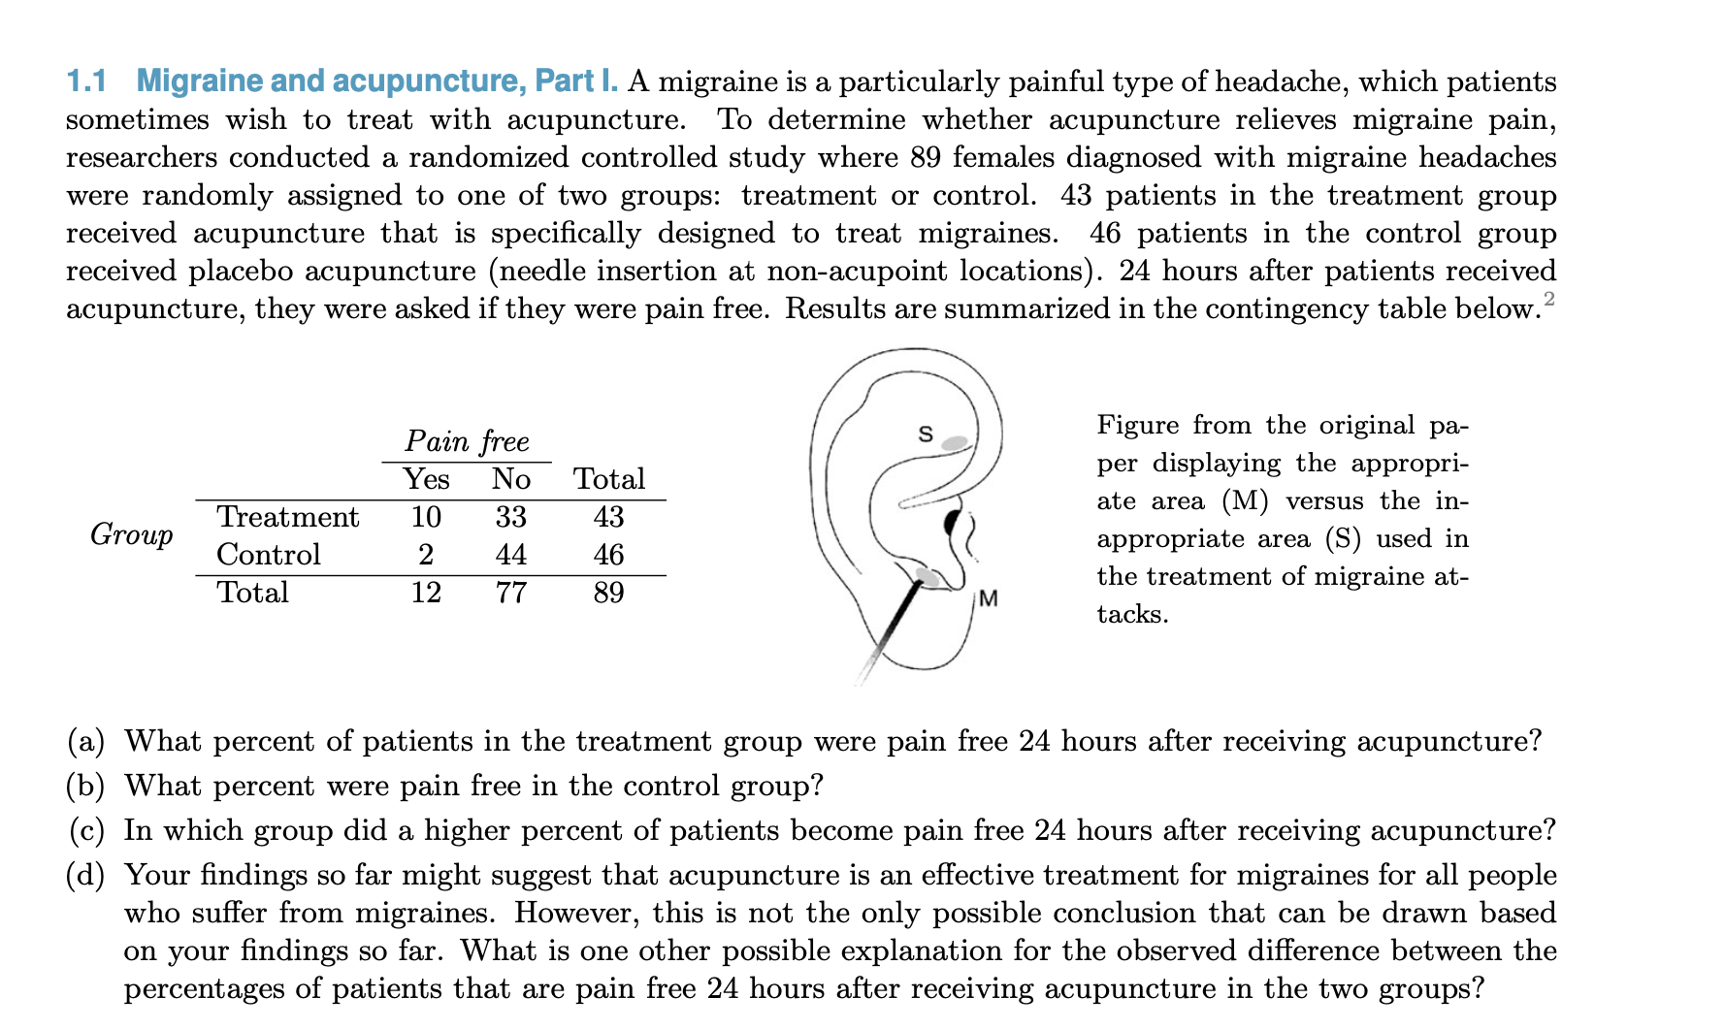
Assignment 1 Problem 1.1

Slide 5
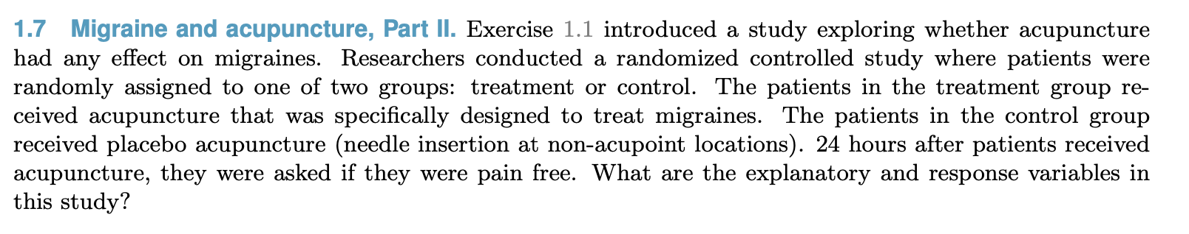
Assignment 1 Problem 1.7

Slide 6
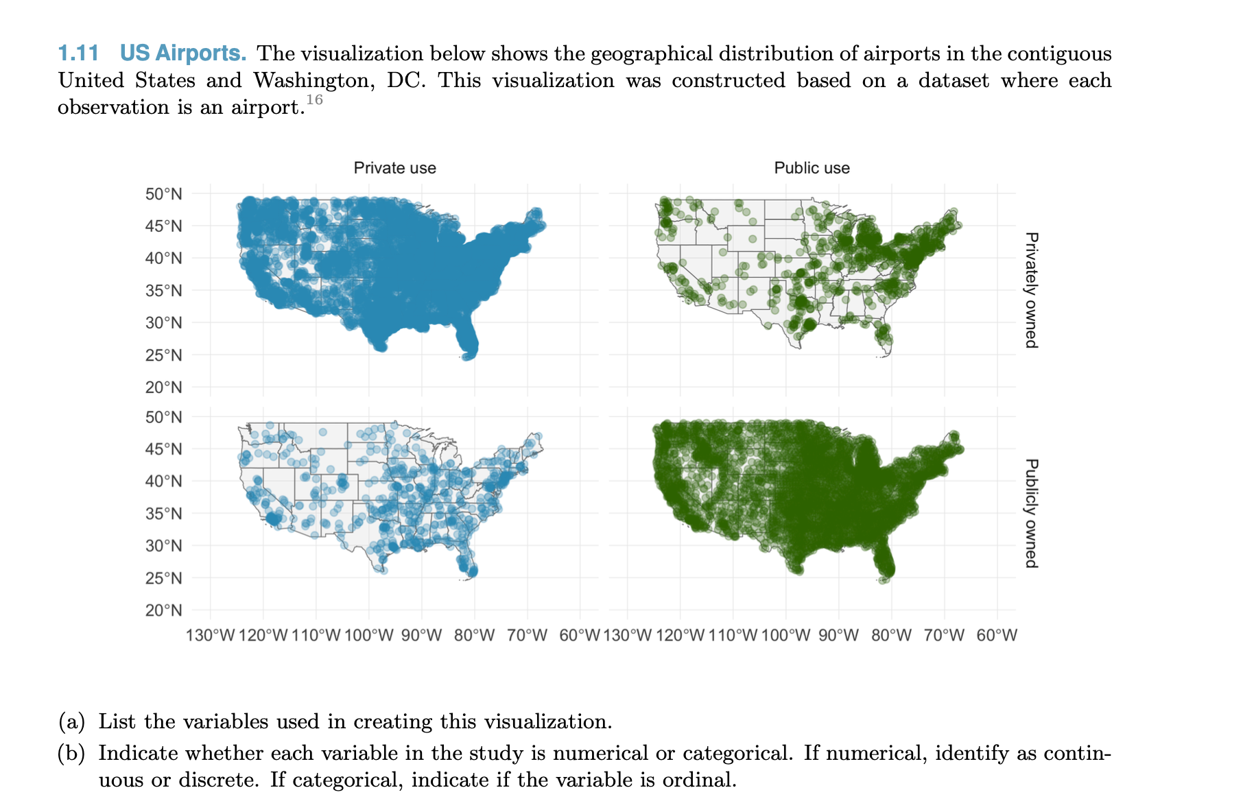
Assignment 1 Problem 1.11

Slide 7
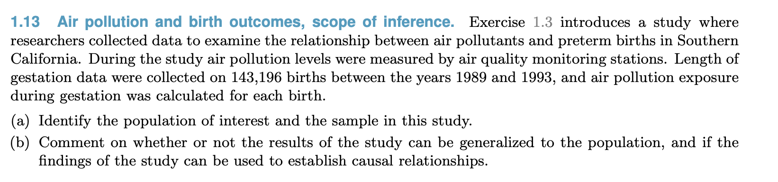
Assignment 1 Problem 1.13
Concepts: Population & Sample

Slide 8
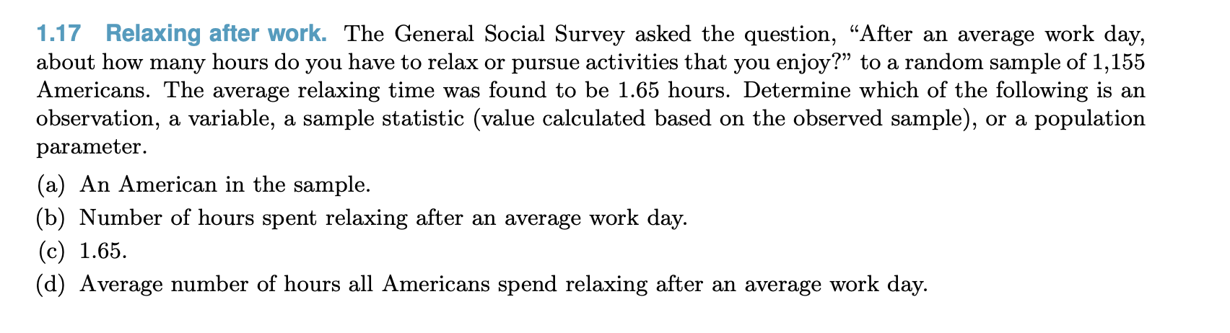
Assignment 1 Problem 1.17

Slide 9
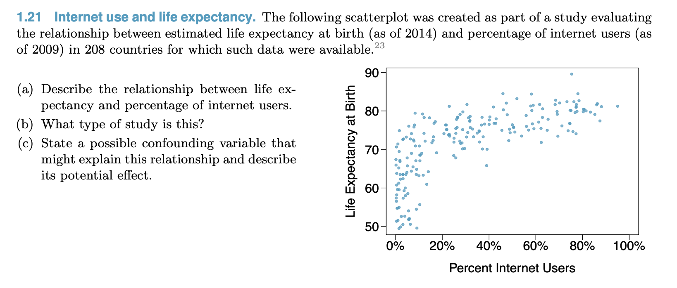
Assignment 1 Problem 1.21
Relationships between variables
Several studies

Slide 10
Assignment 1 Problem 1.27
Sampling methods: simple random sampling, stratified sampling, cluster sample, multistage sample, and convenience sample.
Simple random sampling: a sample is referred to as “simple random” if each case in the population has an equal chance of being included in the final sample and knowing that a case is included in a sample does not provide useful information about which other cases are included.
Stratified sampling: The population is divided into groups called strata. → simple random sampling is employed within each stratum.
Cluster sample: We break up the population into many groups, called clusters. → sample a fixed number of clusters and include all observations from each of those clusters in the sample.
Multistage sample: collect a random sample within each selected cluster.
Convenience sample: those samples are the easiest for the researcher to access.

Slide 11
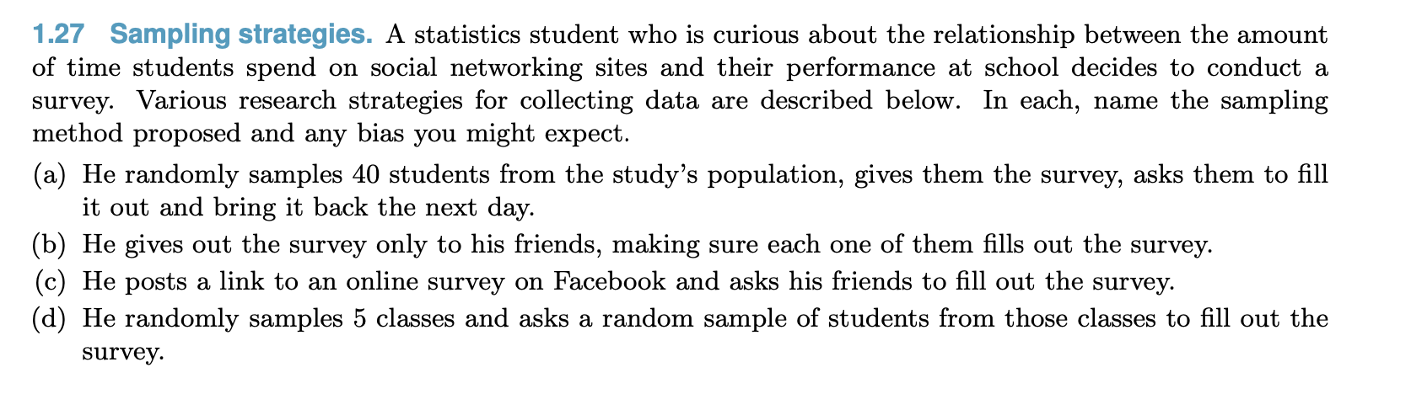
Assignment 1 Problem 1.27

Slide 12
Any questions?

